Slide 1



dashboard pb
View in Power BI
Last data refresh:
4/20/2023 6:03:26 PM UTC
Downloaded at:
4/20/2023 6:32:30 PM UTC

Slide 2
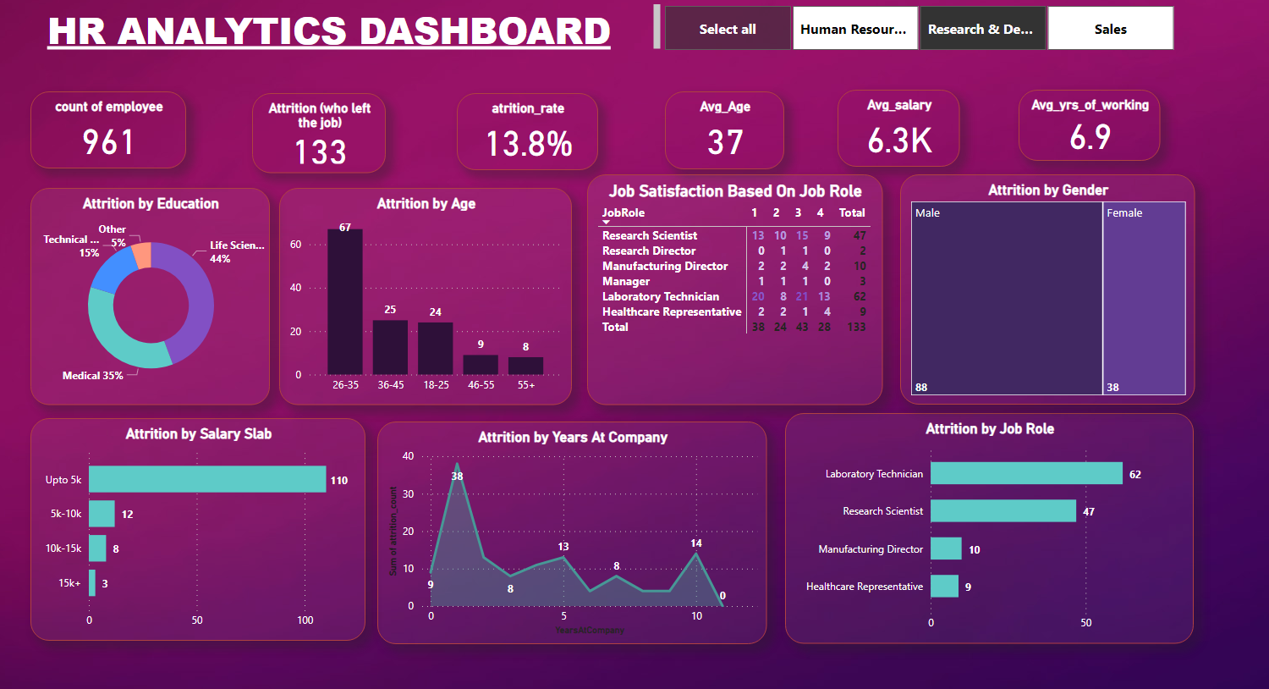
Page 1
Notes:
count of employee
No alt text provided
atrition_rate
No alt text provided
Avg_Age
No alt text provided
Attrition (who left the job)
No alt text provided
Avg_salary
No alt text provided
Avg_yrs_of_working
No alt text provided
Attrition by Education
No alt text provided
Attrition by Age
No alt text provided
Job Satisfaction Based On Job Role
No alt text provided
Attrition by Salary Slab
No alt text provided
Attrition by Job Role
No alt text provided
Attrition by Years At Company
No alt text provided
Attrition by Gender
No alt text provided
slicer
No alt text provided
textbox
No alt text provided

